Slide 1

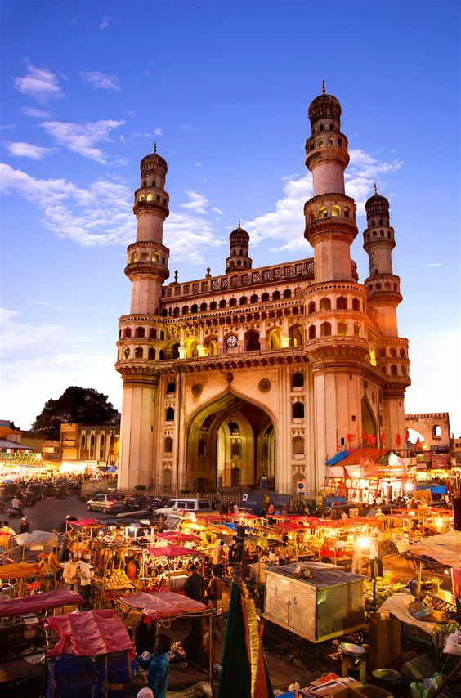
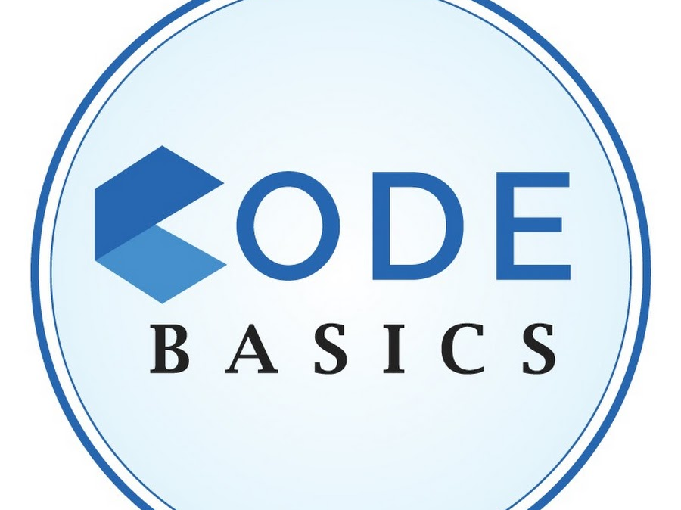
TELANGANA GROWTH ANALYSIS
By Archana Maringanti

Slide 2
Objective:
• Explore Stamp Registration, Transportation and Ts-Ipass Datasets. Understand their attributes, categories and time period.
• Analyze trends and patterns within each department.
• Identify growth opportunities and areas needing attention.
• Find correlation among these departments and report the overall growth of the state through insights and relevant visuals such as shape maps.

Slide 3
Resources Provided
Dataset required to generate Insights
Metadata
Research Questions and Recommendations
Telangana District Map JSON file

Slide 4
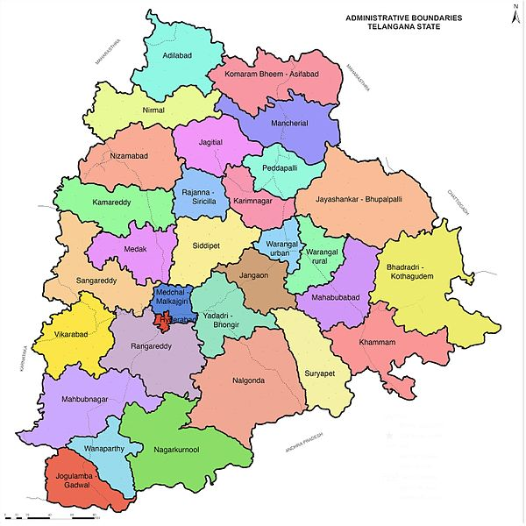
Introduction
Telangana is the 29th and the youngest state in the Union of India, formed on 2nd June 2014. With Hyderabad as its capital, Telangana is one of the fastest-growing states in India and has emerged as a major economic and technological hub.
The state re-organized 10 districts into 33 districts, 459 mandals into 612 mandals, and 8,368 Gram Panchayats into 12,769 Gram Panchayats.

Slide 5
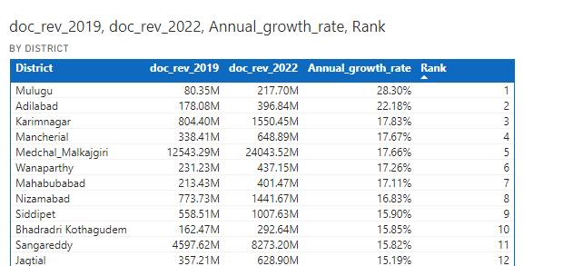
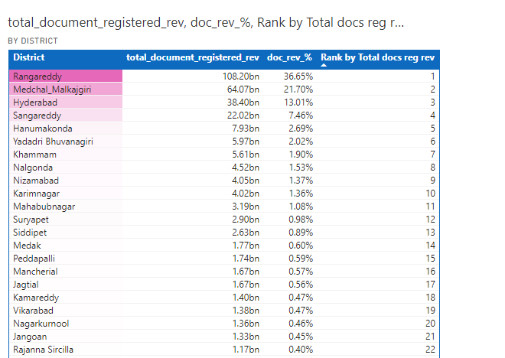
STAMP REGISTRATION:
1. How does the revenue generated from document registration vary across districts in Telangana? List down the top 5 districts that showed the highest document registration revenue growth between FY 2019 and 2022.

Slide 6
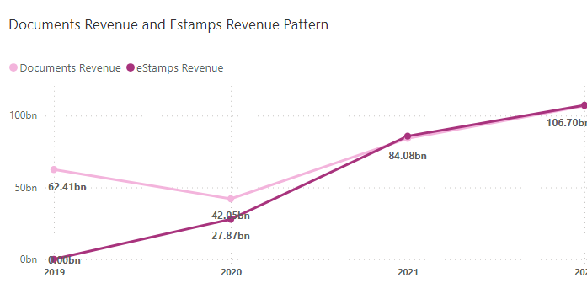
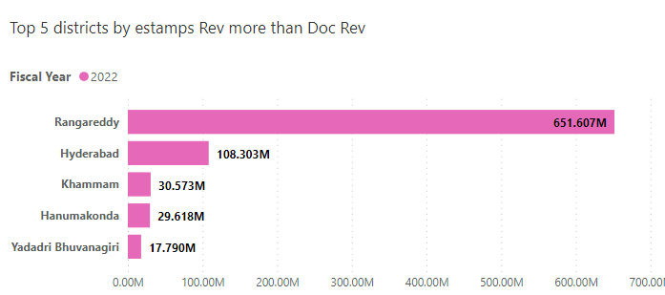
STAMP REGISTRATION:
2. How does the revenue generated from document registration compare to the revenue generated from e-stamp challans across districts? List down the top 5 districts where e-stamps revenue contributes significantly more to the revenue than the documents in FY 2022?

Slide 7
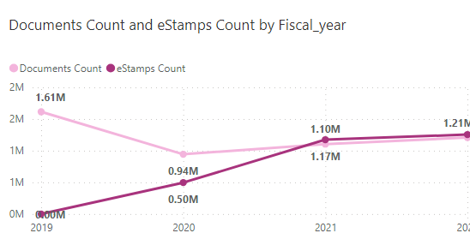
STAMP REGISTRATION:
3. Is there any alteration of e-Stamp challan count and document registration count pattern since the implementation of e-Stamp challan? If so, what suggestions would you propose to the government?
Yes, there is significant change in the e-Stamp challan count and document registration count. Doc - 1.21M,
eStamps - 1.25M.
The initiation of eStamps challan is customer friendly. Payments can be made from the comfort of his/her home.
Mainly it reduces the tedious effort of maintaining challan register. Possibility of counterfeit challan is eliminated.
I propose to increase the awareness of paying stamp duty through online mode in rural areas while continuing manual services.

Slide 8
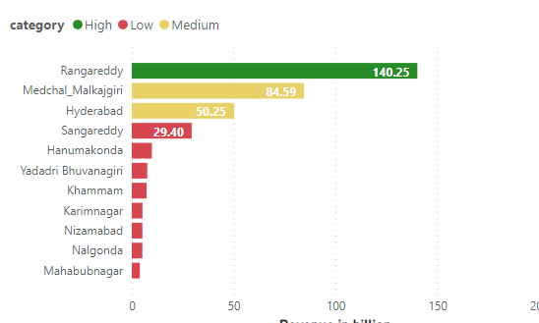
STAMP REGISTRATION:
4. Categorize districts into three segments based on their stamp registration revenue generation during the fiscal year 2021 to 2022.

Slide 9
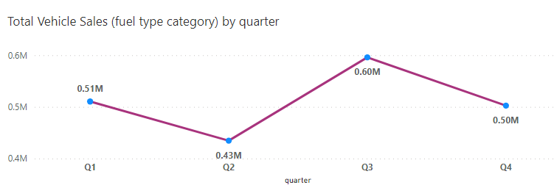
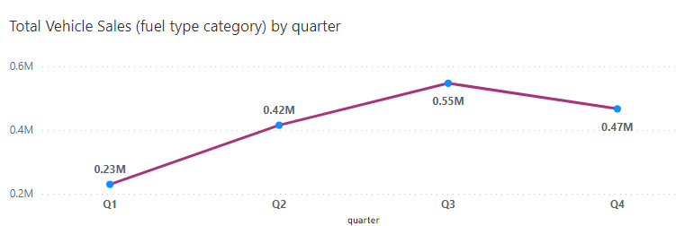
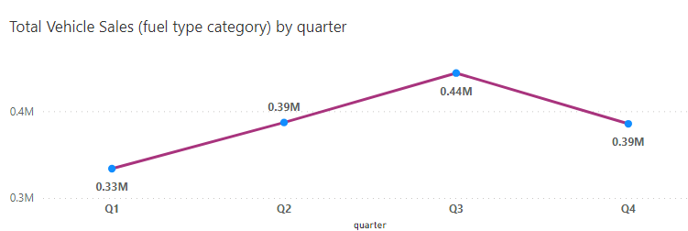
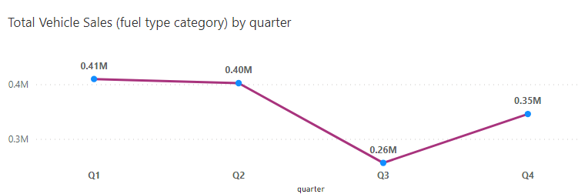
TRANSPORTATION:
5. Investigate whether there is any correlation between vehicle sales and specific months or seasons in different districts. Are there any months or seasons that consistently show higher or lower sales rate, and if yes, what could be the driving factors? (Consider Fuel-Type category only)
2019
2020
2021
2022

Slide 10
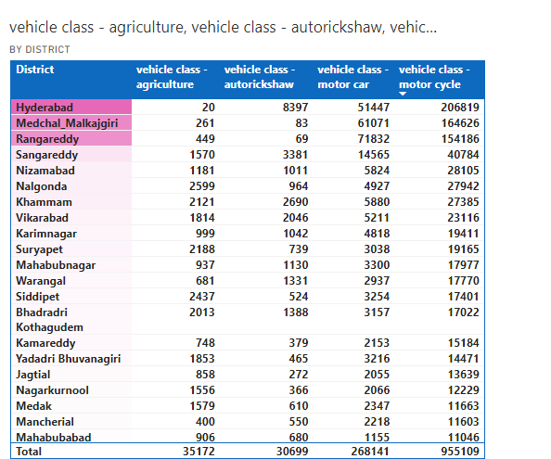
TRANSPORTATION:
6. How does the distribution of vehicles vary by vehicle class (MotorCycle, MotorCar, AutoRickshaw, Agriculture) across different districts? Are there any districts with a predominant preference for a specific vehicle class? Consider FY 2022 for analysis.
As can be seen from the report, there is a predominant preference for Motorcycle across different districts in FY 2022.

Slide 11
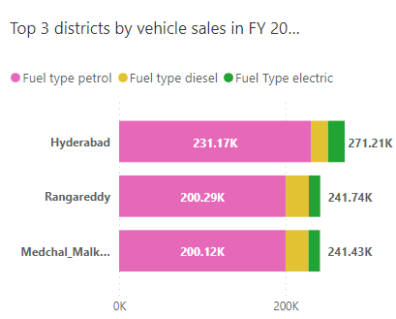
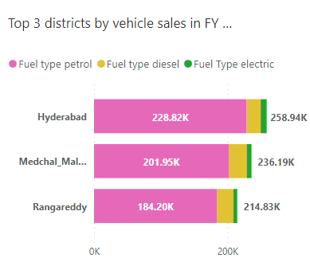
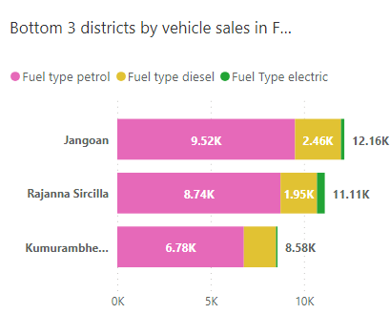
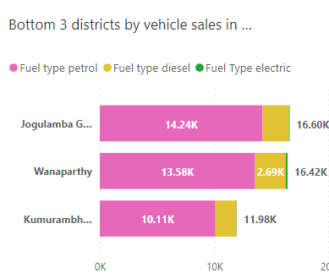
TRANSPORTATION:
7. List down the top 3 and bottom 3 districts that have shown the highest and lowest vehicle sales growth during FY 2022 compared to FY 2021? (Consider and compare categories: Petrol, Diesel and Electric)
2022
2021
2022
2021

Slide 12
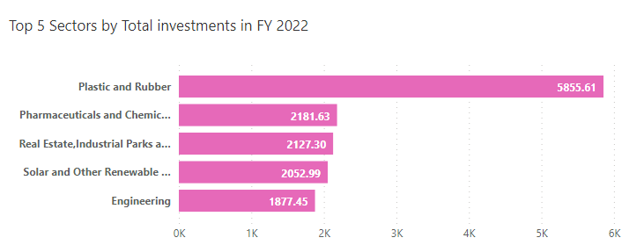
Ts-Ipass (Telangana State Industrial Project Approval and Self Certification System)
8. List down the top 5 sectors that have witnessed the most significant investments in FY 2022.

Slide 13
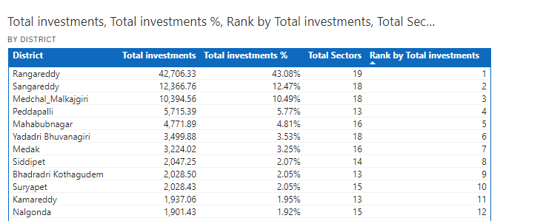
Ts-Ipass (Telangana State Industrial Project Approval and Self Certification System)
9. List down the top 3 districts that have attracted the most significant sector investments during FY 2019 to 2022? What factors could have led to the substantial investments in these particular districts?
Medchal – Malkajgiri is a well-connected district with 3 national highways and 2 state highways apart from many roadways running across the district. The district can be described as the link between Hyderabad and the north Telangana.
Medchal – Malkajgiri District is having (32) Industrial Estates/IP/SEZs , huge Market Facility, having Industrial Training Institutions.
The Ranga Reddy District is playing an important role in the development of industries in the State because of its proximity to Hyderabad City. The district is in more advantageous position for setting up of industries as the location is nearer to the market and also the easy availability of required technical man-power.
Sangareddy is a major commercial and industrial center in the region. The town is home to several industries, including pharmaceuticals, textiles, and manufacturing.

Slide 14
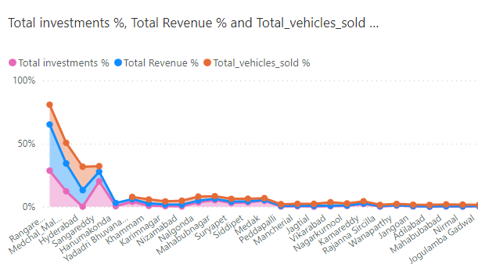
Ts-Ipass (Telangana State Industrial Project Approval and Self Certification System)
10. Is there any relationship between district investments, vehicles sales and stamps revenue within the same district between FY 2021 and 2022?
It is evident from the line chart that Investments, vehicle sales and stamps revenue are interrelated. Increase in investments results in increased stamp revenue which in turn results in high vehicle sales.

Slide 15
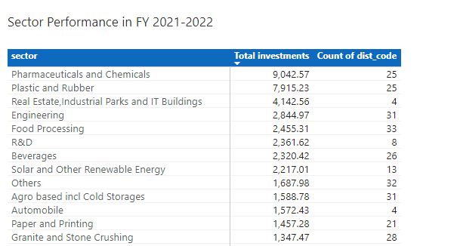
Ts-Ipass (Telangana State Industrial Project Approval and Self Certification System)
11. Are there any particular sectors that have shown substantial investment in multiple districts between FY 2021 and 2022?

Slide 16
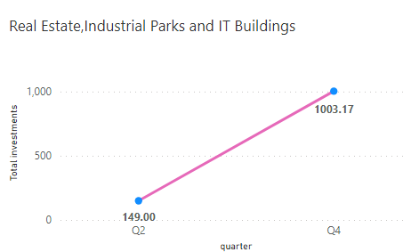
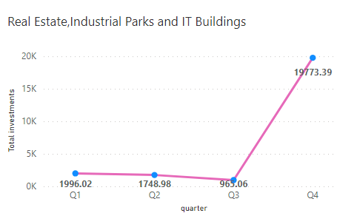
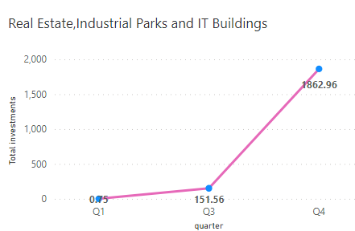
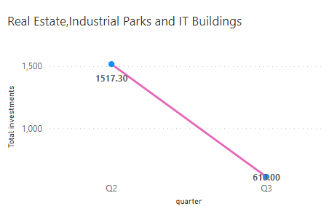
Ts-Ipass (Telangana State Industrial Project Approval and Self Certification System)
12. Can we identify any seasonal patterns or cyclicality in the investment trends for specific sectors? Do certain sectors experience higher investments during particular months?
2019
2020
2021
2022

Slide 17
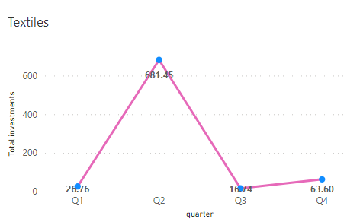
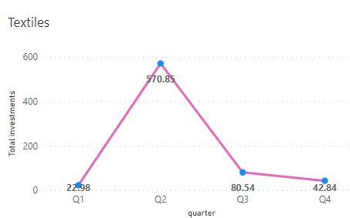
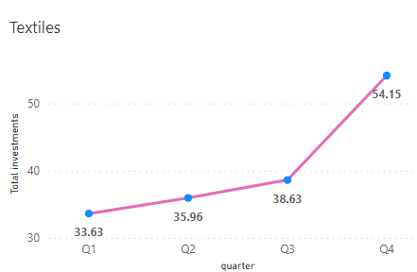
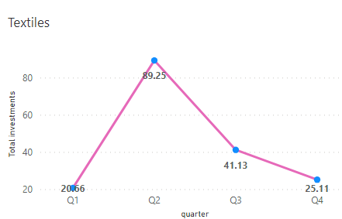
Ts-Ipass (Telangana State Industrial Project Approval and Self Certification System)
12. Can we identify any seasonal patterns or cyclicality in the investment trends for specific sectors? Do certain sectors experience higher investments during particular months?
2019
2020
2022
2021

Slide 18
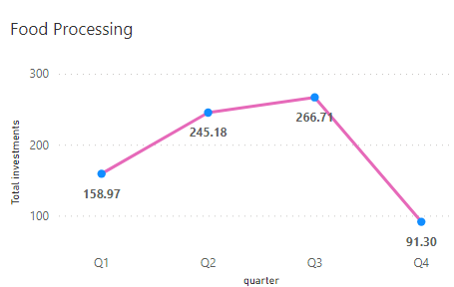
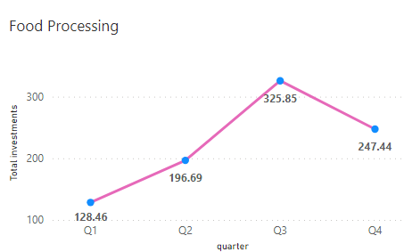
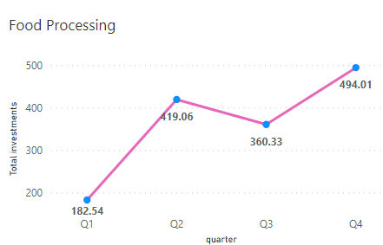
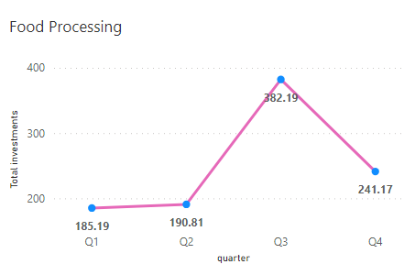
Ts-Ipass (Telangana State Industrial Project Approval and Self Certification System)
12. Can we identify any seasonal patterns or cyclicality in the investment trends for specific sectors? Do certain sectors experience higher investments during particular months?
2019
2020
2022
2021

Slide 19
SECONDARY QUESTIONS:
1. What are the top 5 districts to buy commercial properties in Telangana? Justify your answer.
1.Hyderabad
2.Sangareddy
3.Rangareddy
4.Medchal-Malkajigiri
5.Warangal
Developing of two industrial corridors: Hyderabad-Warangal Industrial Corridor and Hyderabad – Nagpur Industrial Corridor.

Slide 20
SECONDARY QUESTIONS:
2. What significant policies or initiatives were put into effect to enhance economic growth, investments, and employment in Telangana by the current government? Can we quantify the impact of these policies using available data?
Yes, various policies introduced by Telangana Government resulted in subtancial investements all over the state.
Especially TS-iPASS is the game changer which is investor friendly policy. Continuous efforts from the governement to uplift the all sections of the society, introduced various policies providing numerous subsidies and incentives.
Though faced with covid challenges, Telangana was quick to overcome the revenue expenditure in 2020 and succesfully generating surplus revenue from various sectors.

Slide 21
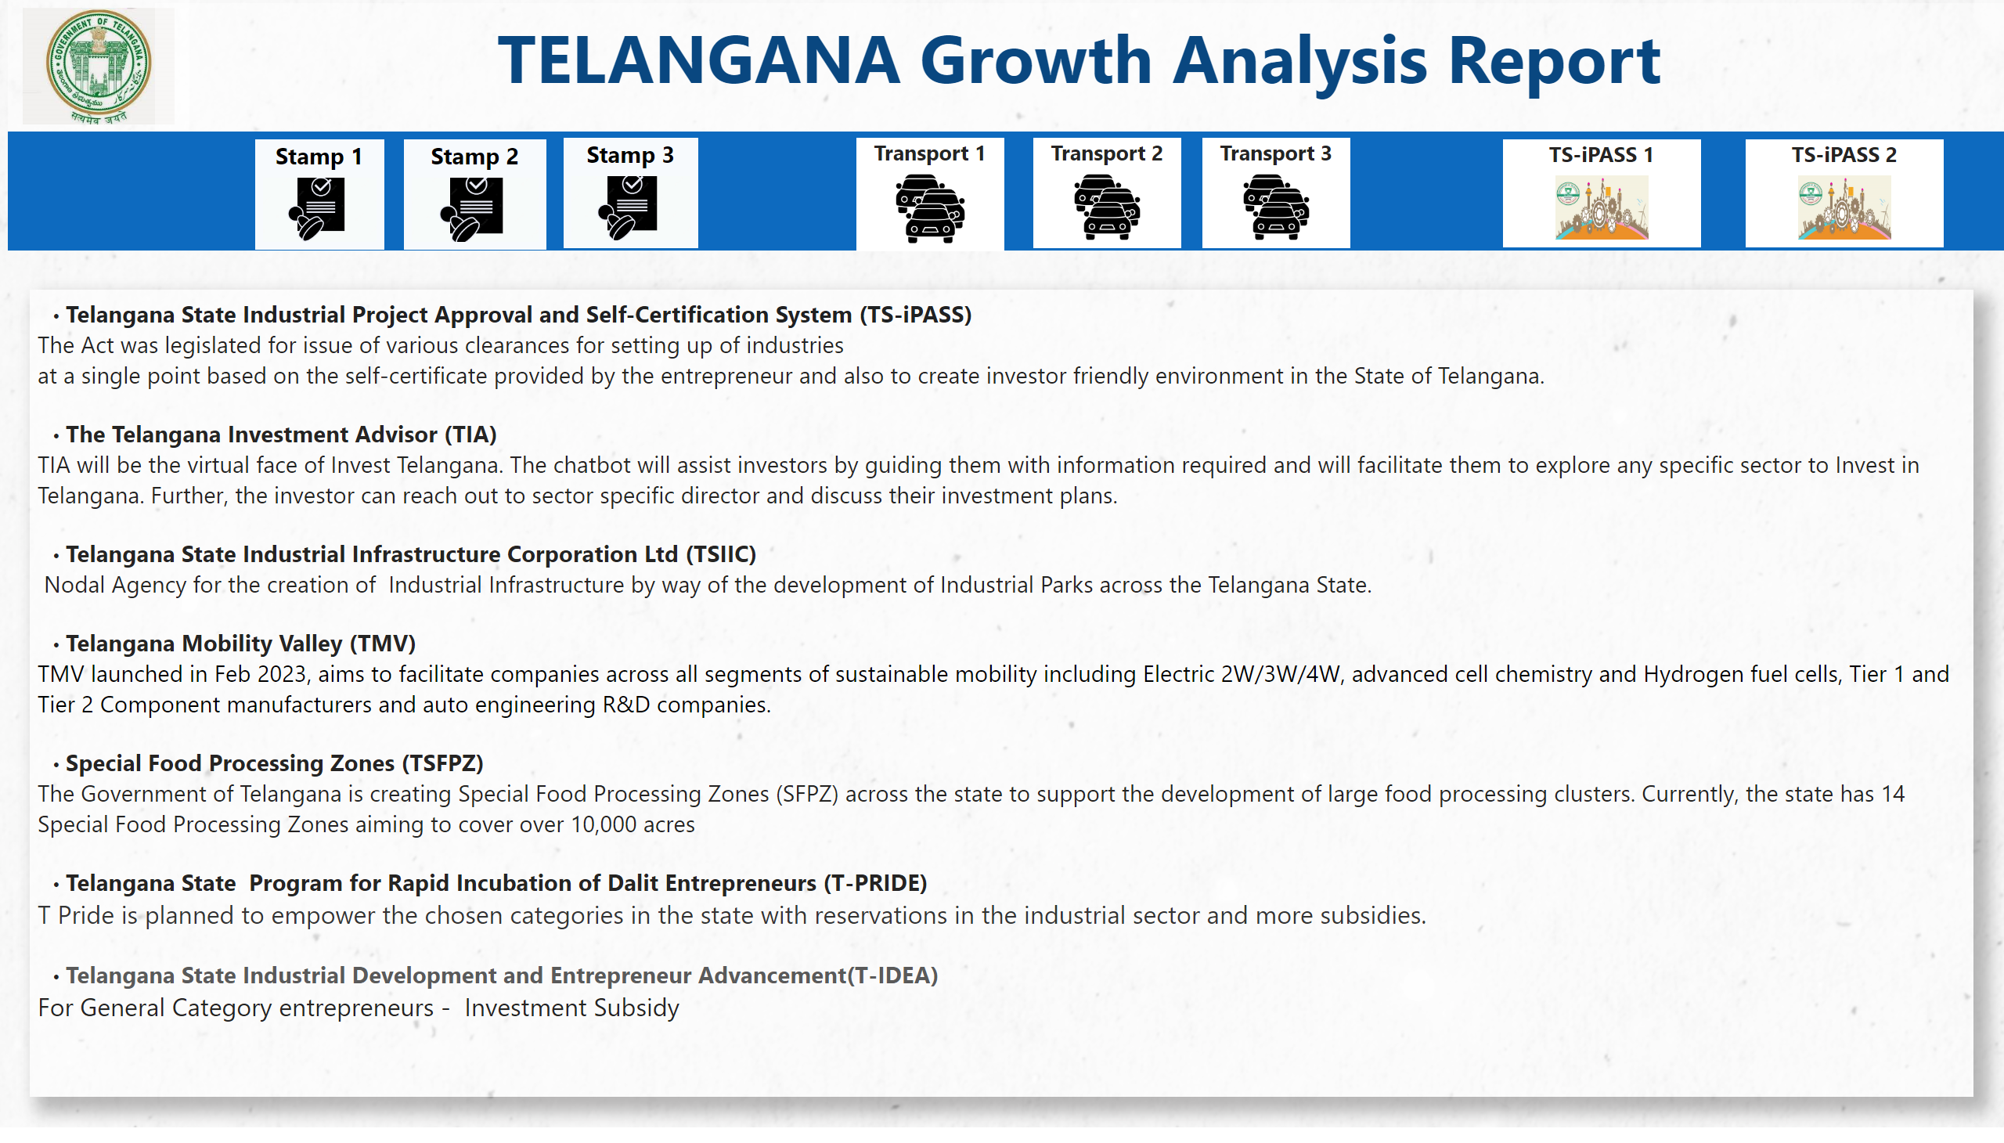
Secondary Insights 2
Notes:
image
No alt text provided
textbox
No alt text provided
shape
No alt text provided
textbox
No alt text provided
Stamp 1
No alt text provided
Stamp 2
No alt text provided
Stamp 3
No alt text provided
Transport 1
No alt text provided
Transport 2
No alt text provided
Transport 3
No alt text provided
TS-iPASS 1
No alt text provided
TS-iPASS 2
No alt text provided

Slide 22
SECONDARY QUESTIONS
3. Provide top 5 Insights & 5 recommendations to Telangana government for sustained growth in the next 5 years based on your analysis.

Slide 23
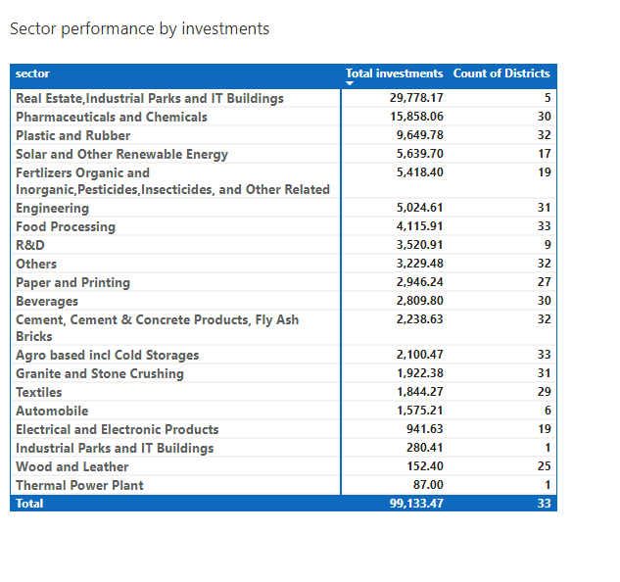
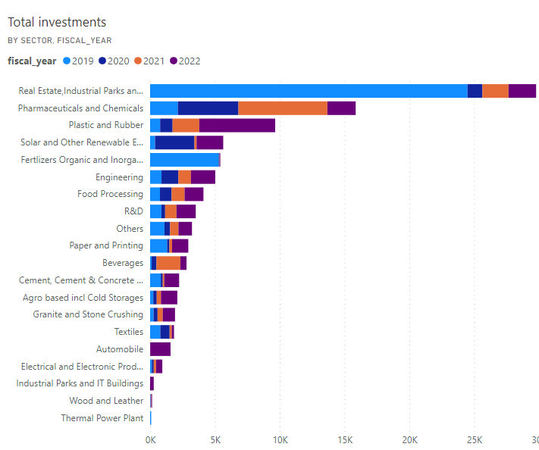
Secondary Insights 2
Notes:
image
No alt text provided
textbox
No alt text provided
shape
No alt text provided
textbox
No alt text provided
Stamp 1
No alt text provided
Stamp 2
No alt text provided
Stamp 3
No alt text provided
Transport 1
No alt text provided
Transport 2
No alt text provided
Transport 3
No alt text provided
TS-iPASS 1
No alt text provided
TS-iPASS 2
No alt text provided

Slide 24
Insights:
There is a decline of investments in the Real estate sector in FY 2022 compared to 2021.
Decline of investments in the Pharmaceutical sector in FY 2022 compared to 2021.
Decline of investments in the investments of Fertilizers Organic and Inorganic Pesticides, Insecticides and Other related sector in FY 2022 compared to 2021.
Decline in the investments in the Textile sector in FY 2022 compared to 2021.
Decline in the investments in the Solar and other Renewable Energy sector in FY 2022 compared to 2021.
Recommendations:
To speed up the projects for which foundation has laid. Industrial corridors, Industrial parks, thermal plant, etc.
Making sure that various policies for different sectors are available to right beneficiaries.
Addressing supply chain issues in Textile industry. Speeding the process of apparel parks set up in Siricilla , Kakatiya and Warangal.
Addressing the issues faced by MSMEs in Pharma Industry. Promote the small and medium scale Pharma companies which are struggling to survive.
High Inflation, Global supply chain issues, High interest rates can be attributed to reduction in investments in real estate and other sectors overall.

